Slide 1
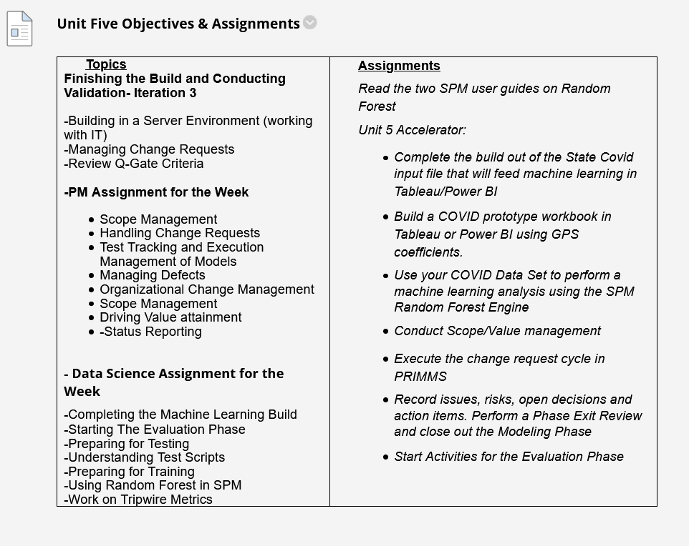

Slide 2
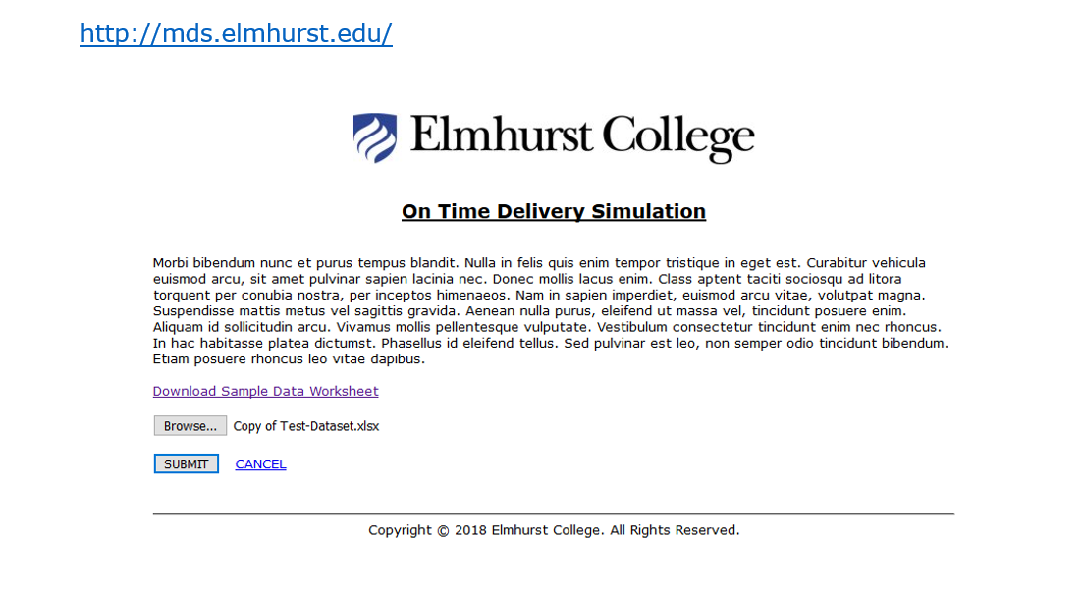

Slide 3
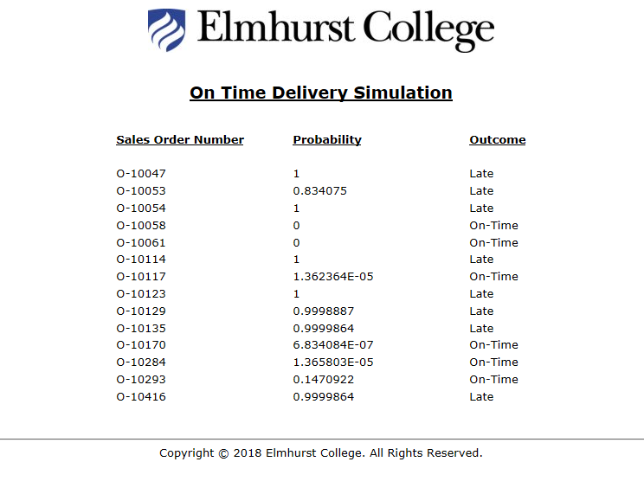

Slide 4
Observations on Accelerator Homework
In X variable selection, consider usefulness of the results and not just the explanatory power. Example: predicting Deaths per 100k from Positives. What is the value?
Policy implications should come from results of the data. Example: Hispanic: could suggest 14 day quarantines upon new arrivals or extra effort to communicate risks.
Plotting predicted versus actual can sometimes give you the best perspective on model performance.

Slide 5
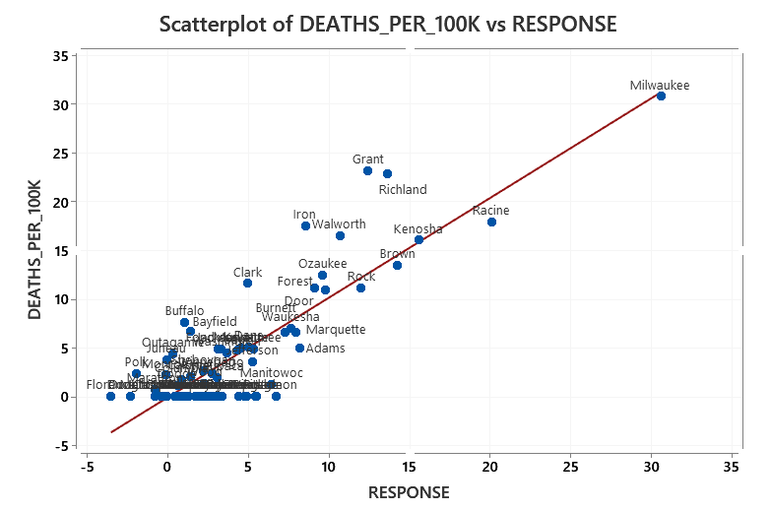
GPS

Slide 6
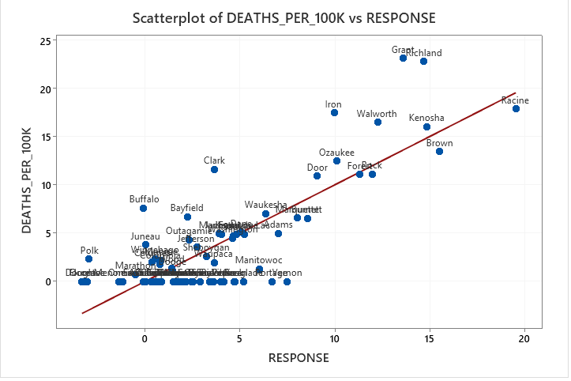
Re-estimated without Milwaukee
Not much difference

Slide 7
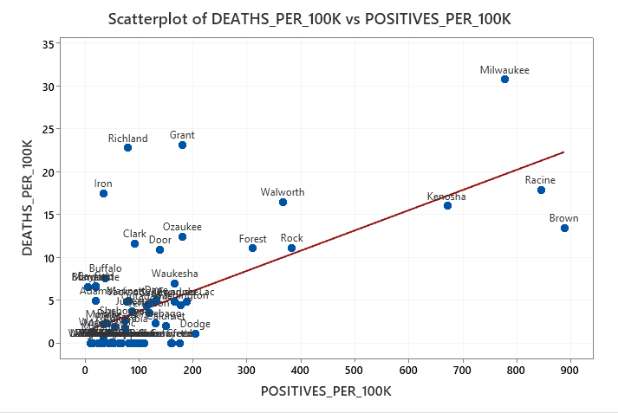
The Importance of Plotting: Wisconsin Example

Slide 8
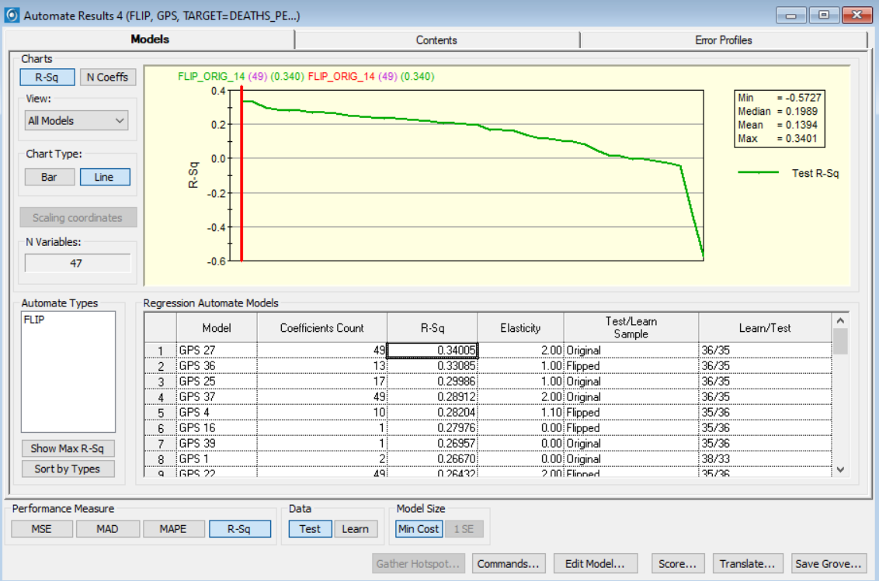

Slide 9
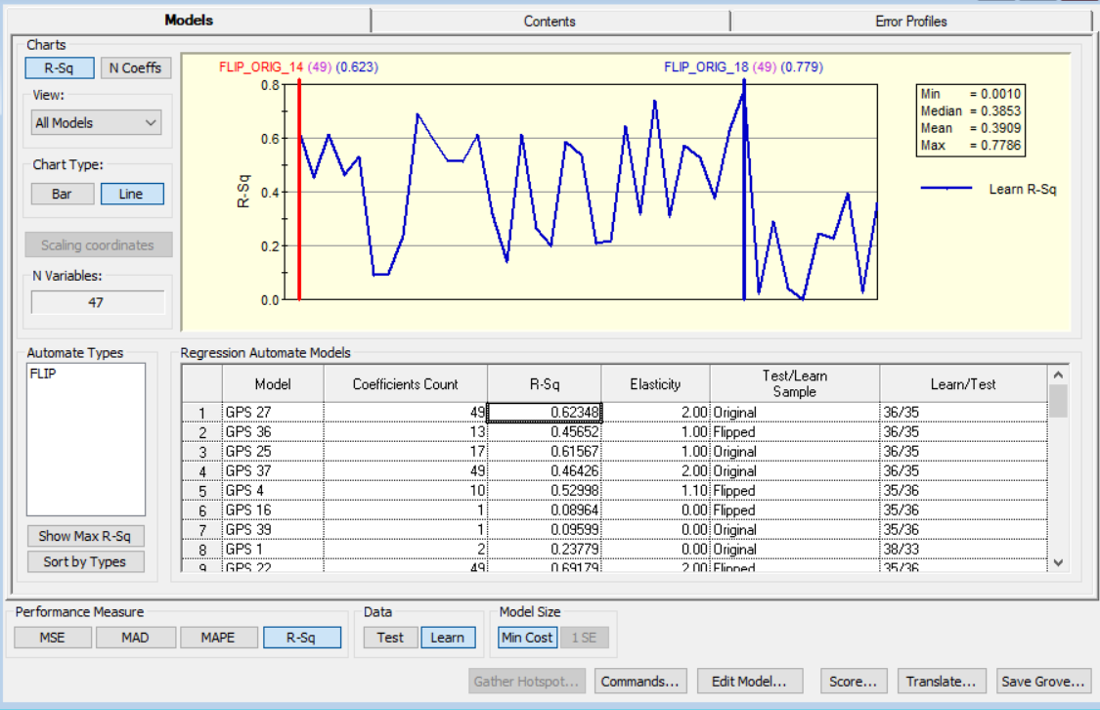

Slide 10
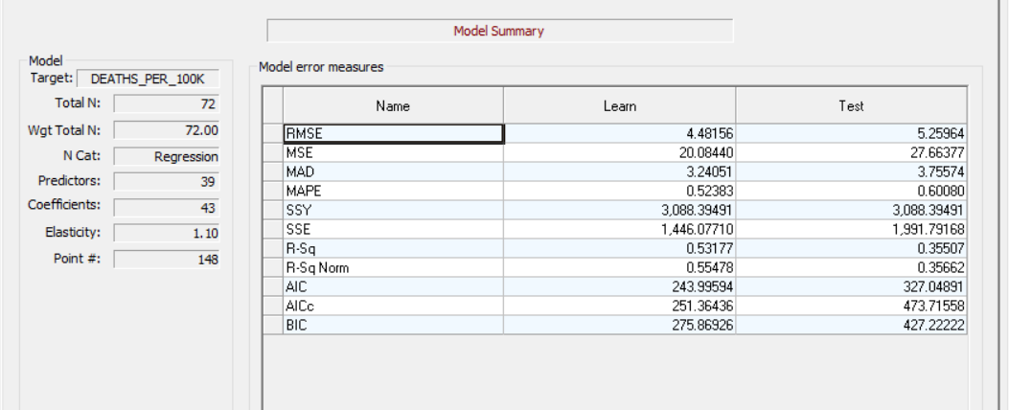
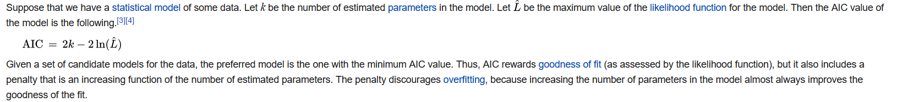
Information Criterion for Information Lost By a Model
AIC and BIC Balances Goodness of Fit with Complexity

Slide 11
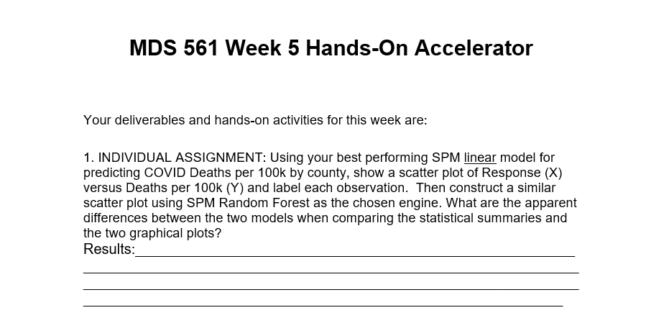

Slide 12
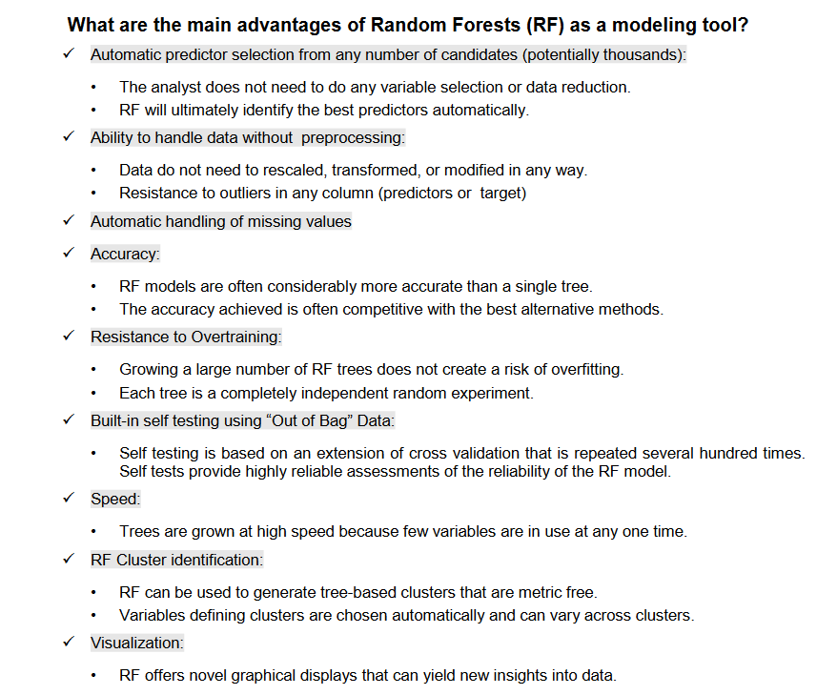

Slide 13
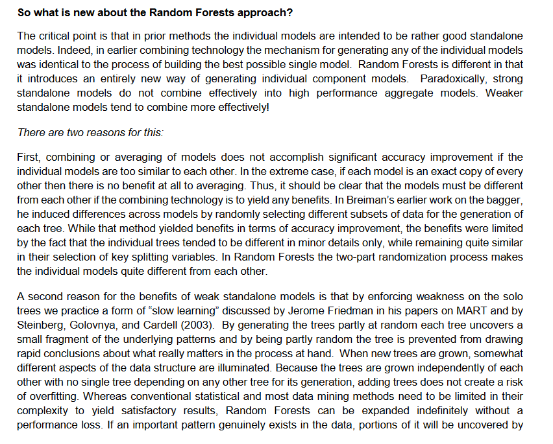

Slide 14
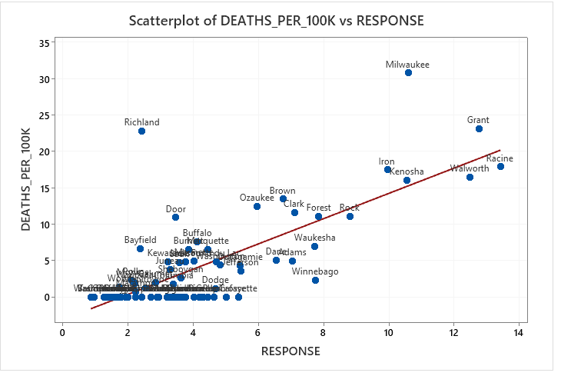
Random Forest Example
Notice the treatment of large city Milwaukee.

Slide 15
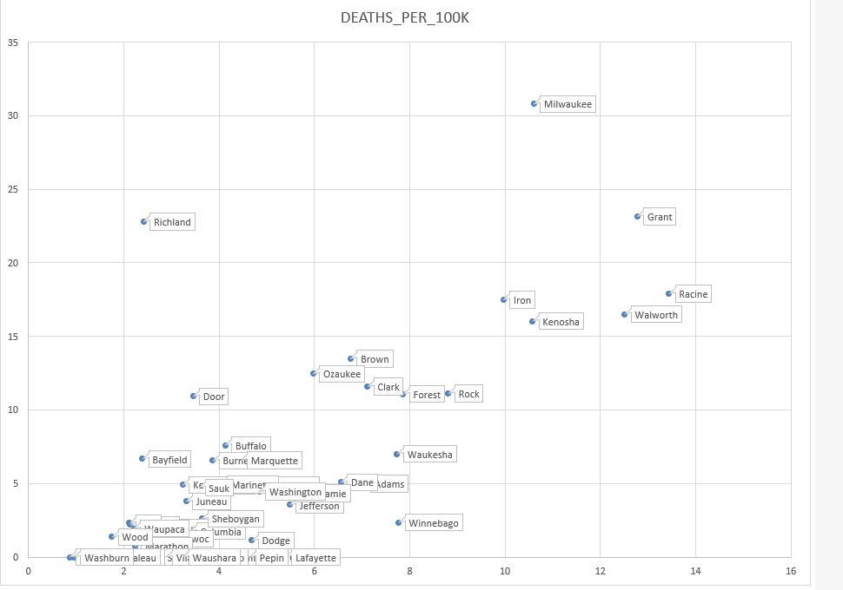
In Excel

Slide 16
GPS

Slide 17
Re-estimated without Milwaukee
Not much difference

Slide 18
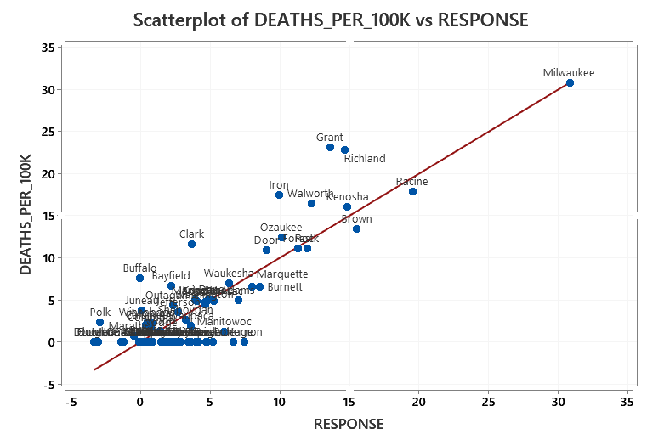
OLS

Slide 19
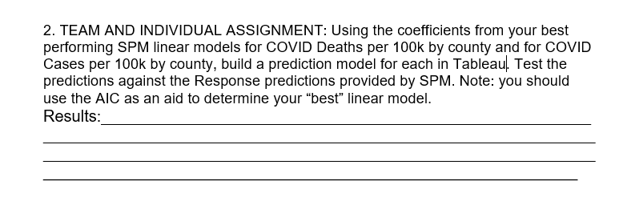

Slide 20
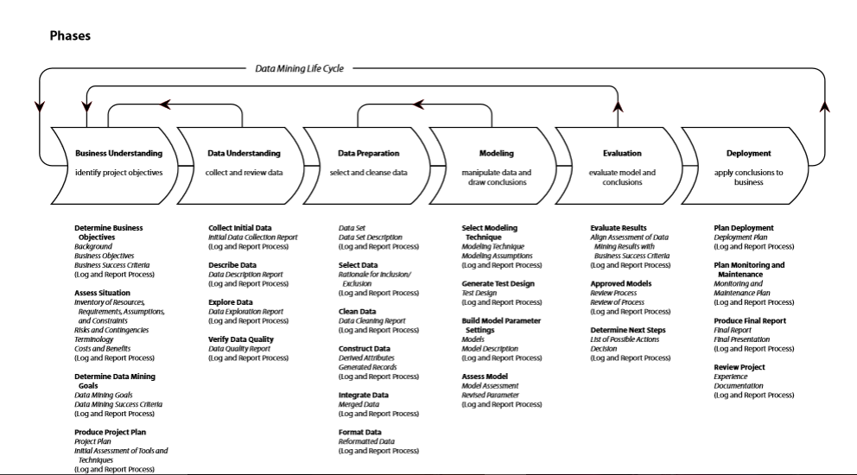
A Revised CRISP-DM Project Methodology with Deliverables
Post Project Monitoring
Deploy To Tableau Production #4
Baseline Model and a report
#1
Deploy Model to PRD
Load/Validate PRD Data
Go Live in PRD
Stabilization
System monitoring
Model Updates
Value Monitoring and
Management
Community Social Media Continues
Project Charter, Value Map and Requirements
Baseline Project Schedule
Business Sign-off and Project Authorization. Scope Change Control
First Baseline Prototype Completed in Dev Environment
Weekly Risk Management Survey—VOT Begins
Issues and Gaps Documented
Phase Exit Review Completed
Weekly Status Begins
Community-Social Media Begins
Third Prototype Created
Test Scripts Created
and Executed in QA
User Acceptance Testing
Completed with full data
Training Scripts Created
User Training Delivered
Issues and Defects Closed
Community Social Media
Continues for communication
Second Prototype Completed i
Future State Process Developed with ETL Data Modeled
Future State Process Documented
Schedule Updated
Issues and Defects Captured and Closed
Phase Exit Review Completed
Weekly VOT Continues
Weekly Status Continues
Community Social Media Continues
Enhanced Model; Create, Validate and Deploy Workbooks and Train Employees #2.
Deploy to Tableau Test #3

Slide 21
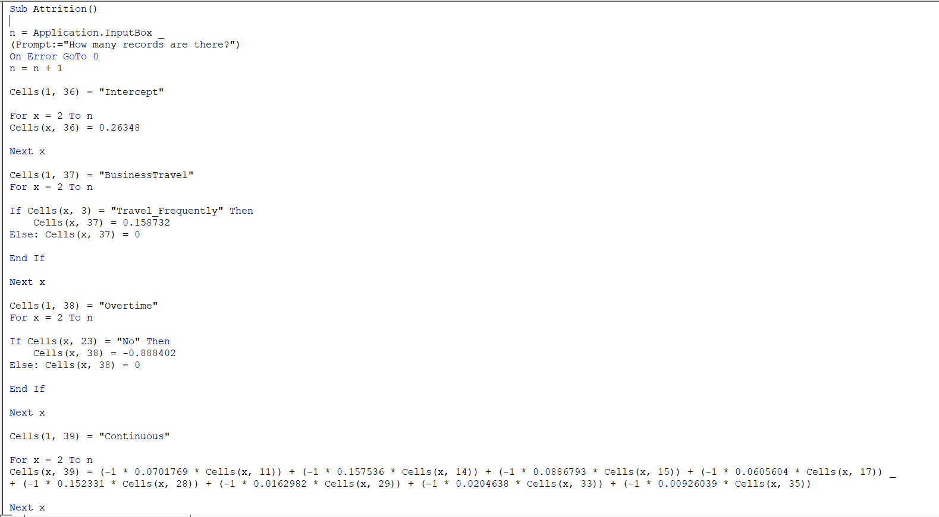
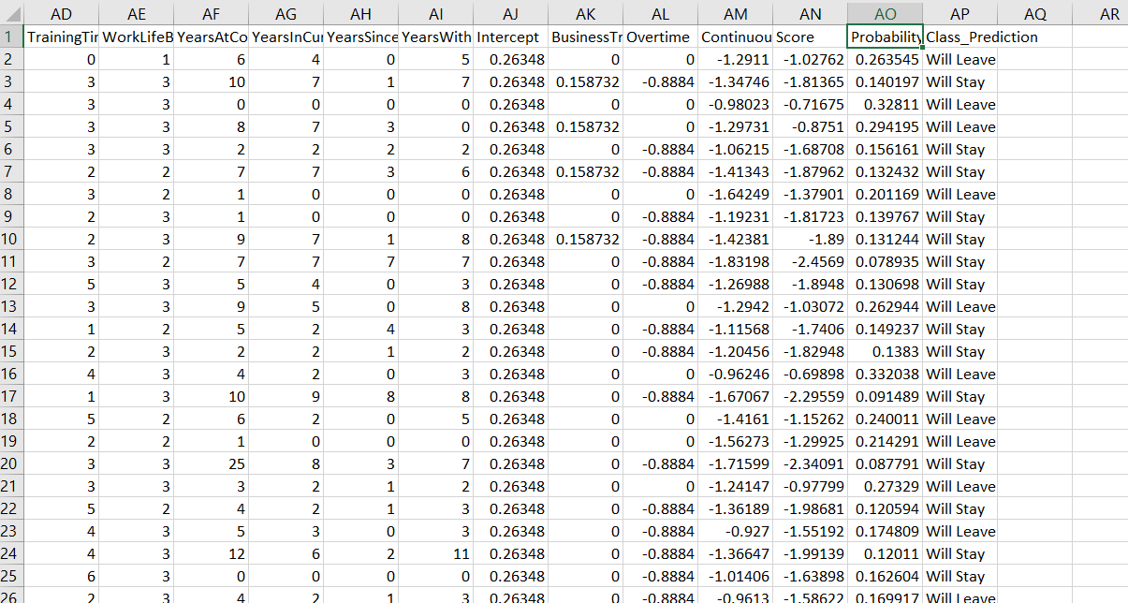
VBA Code in Excel

Slide 22
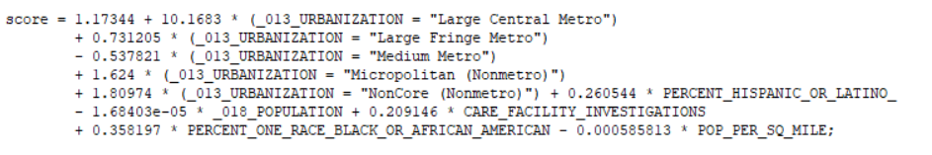
Simple Model Example

Slide 23
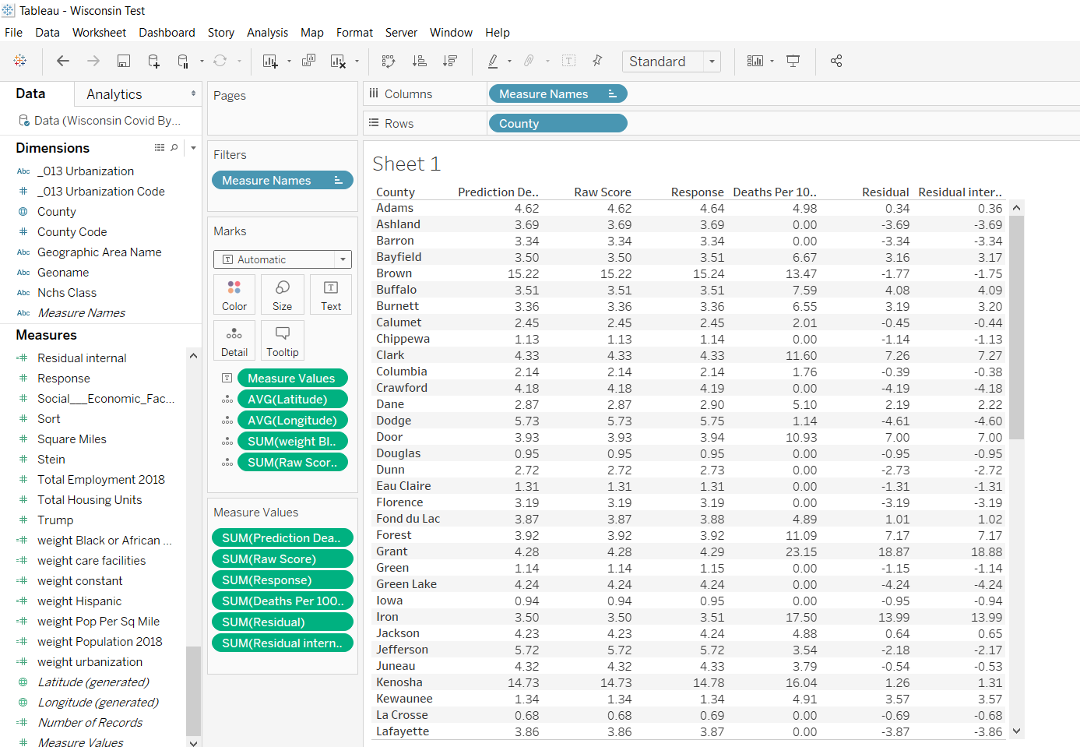
What Your Testing Validation Should Look Like
Having This Deployed Model Available Would Allow Other States To Use It.

Slide 24
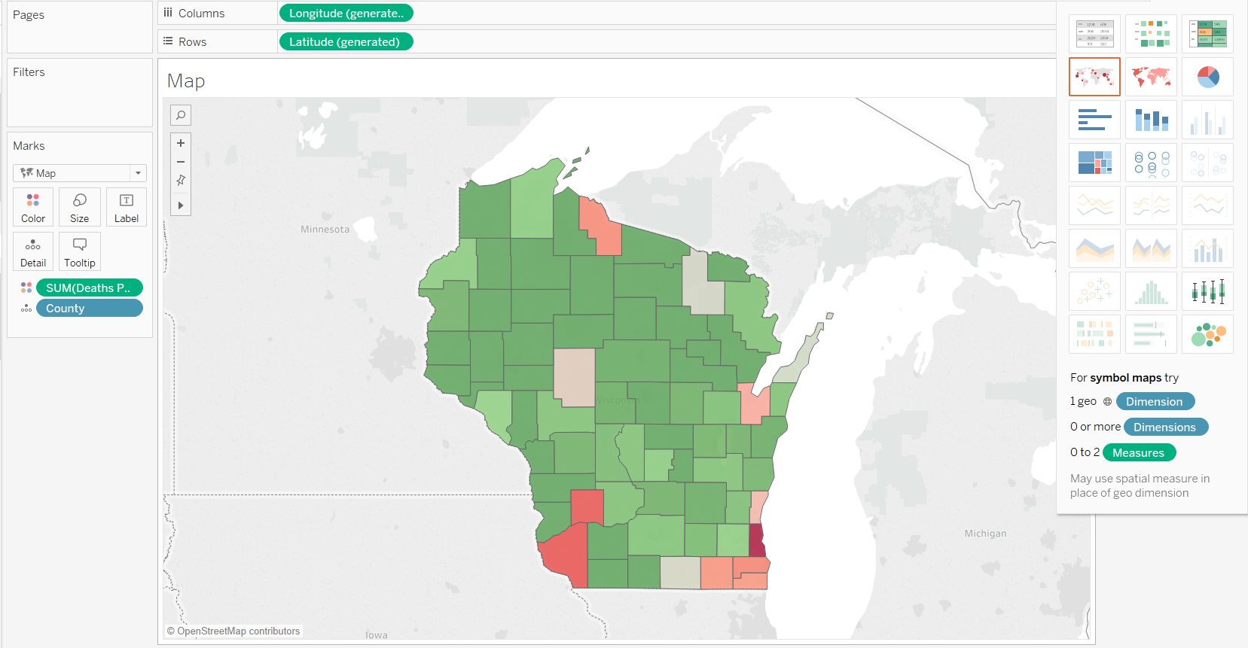
This Sets You Up For Some Additional Deliverables That The Sponsor Wants

Slide 25
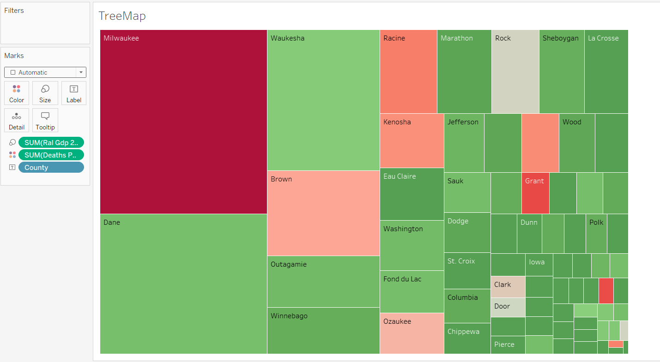
You Will Need Some Additional Data

Slide 26
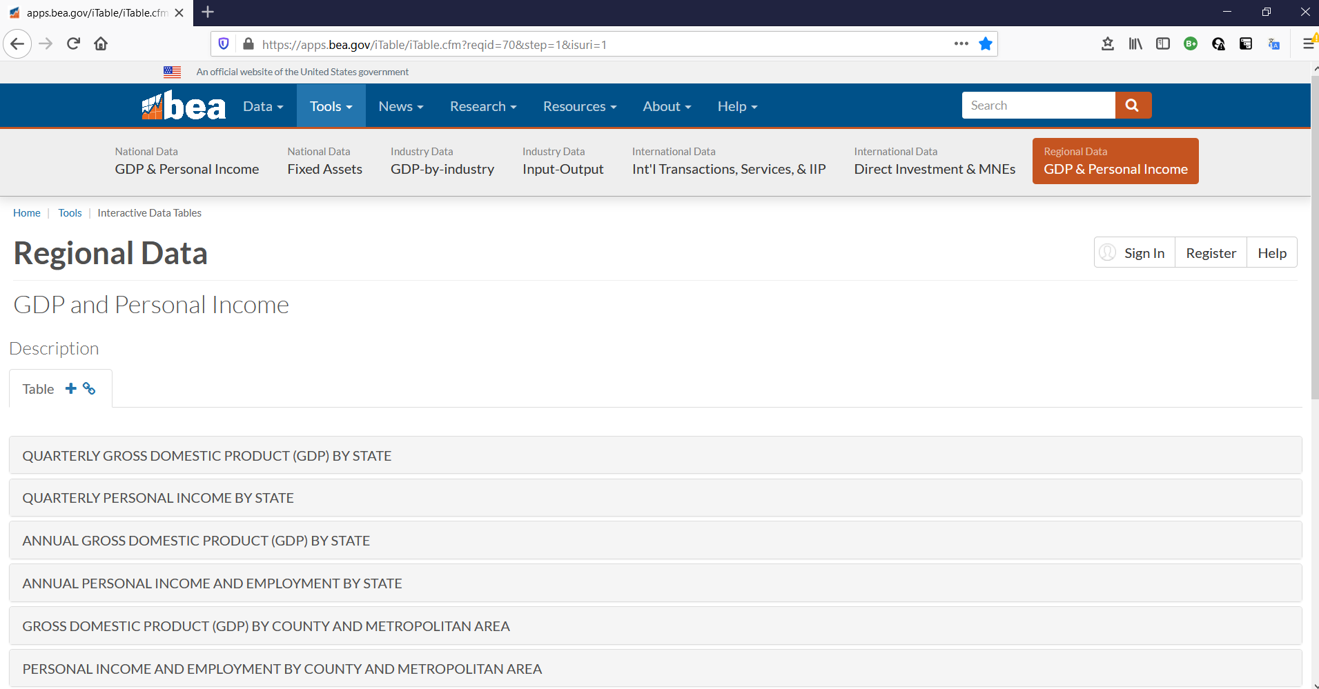
https://apps.bea.gov/iTable/iTable.cfm?reqid=70&step=1&isuri=1

Slide 27
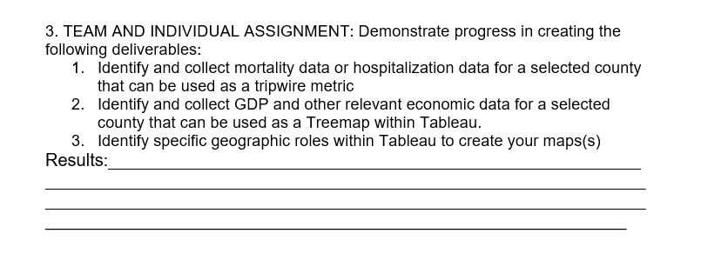

Slide 28
Project Management Deliverables

Slide 29
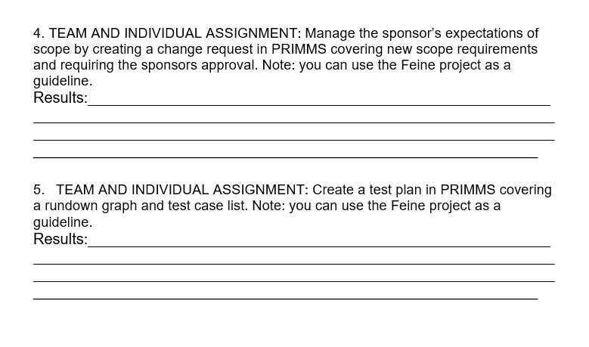

Slide 30
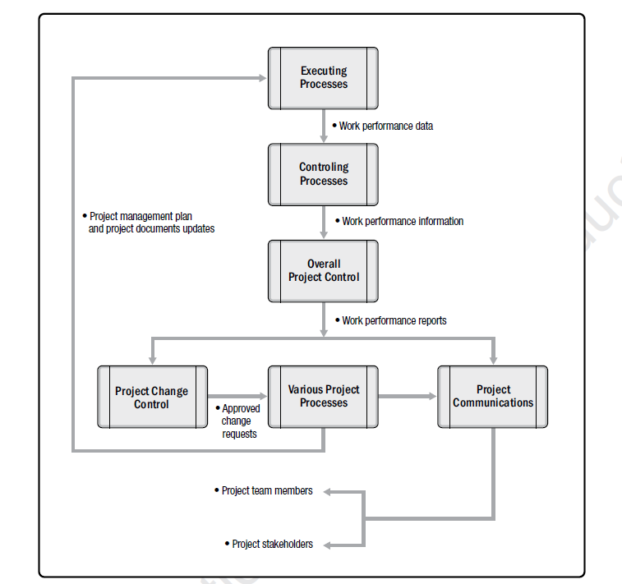
Change Control is the Foundation of Scope Management and the Essence of Contract Management

Slide 31
Scope Management Challenge
$
New Benefit
Sponsor wants more (visible) but additional costs are not visible
∆ Scope
Original Benefit
Cost of Changing/Adding Scope
Value From Changing/Adding Scope
Time

Slide 32
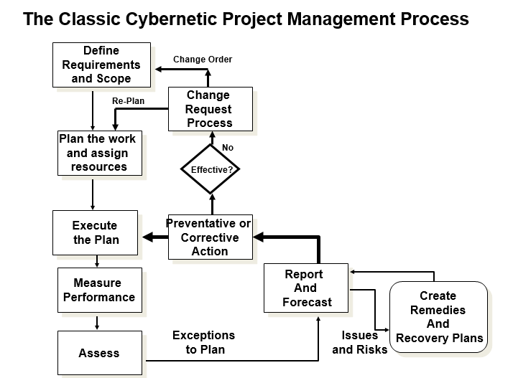

Slide 33
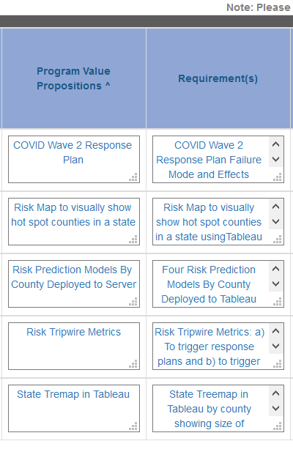
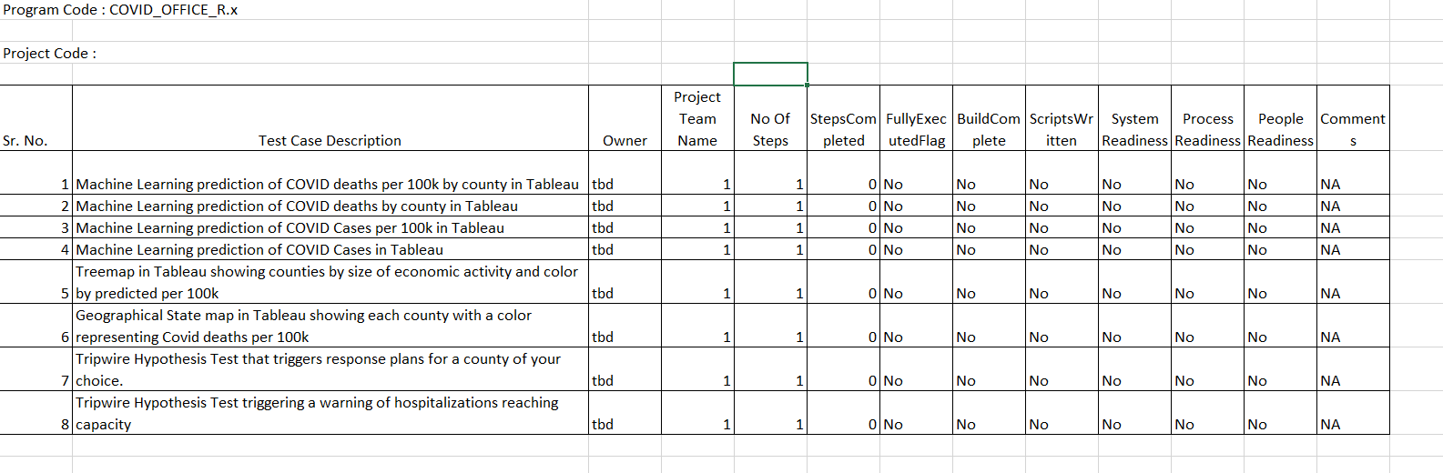
Current View of Scope Targeted For Completion By End of Week 8

Slide 34
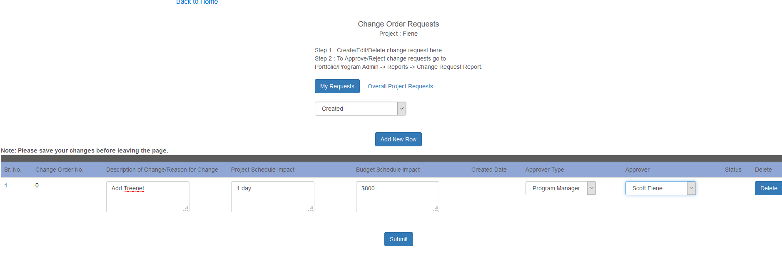

Slide 35
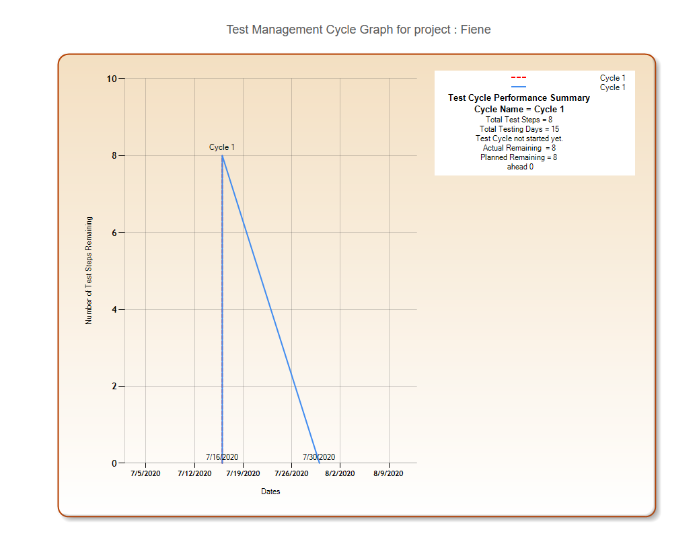

Slide 36
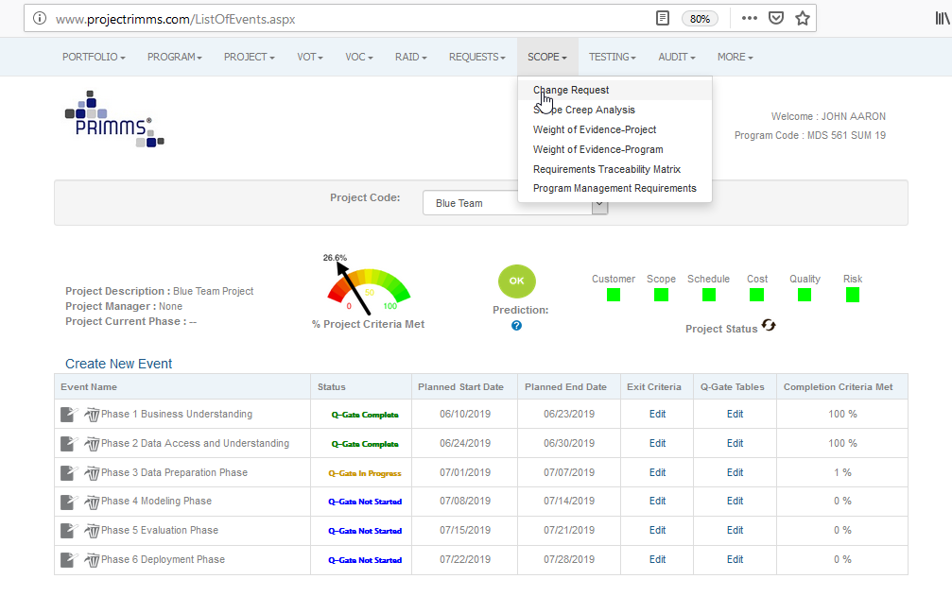
Initiating a Change Request in PRIMMS

Slide 37
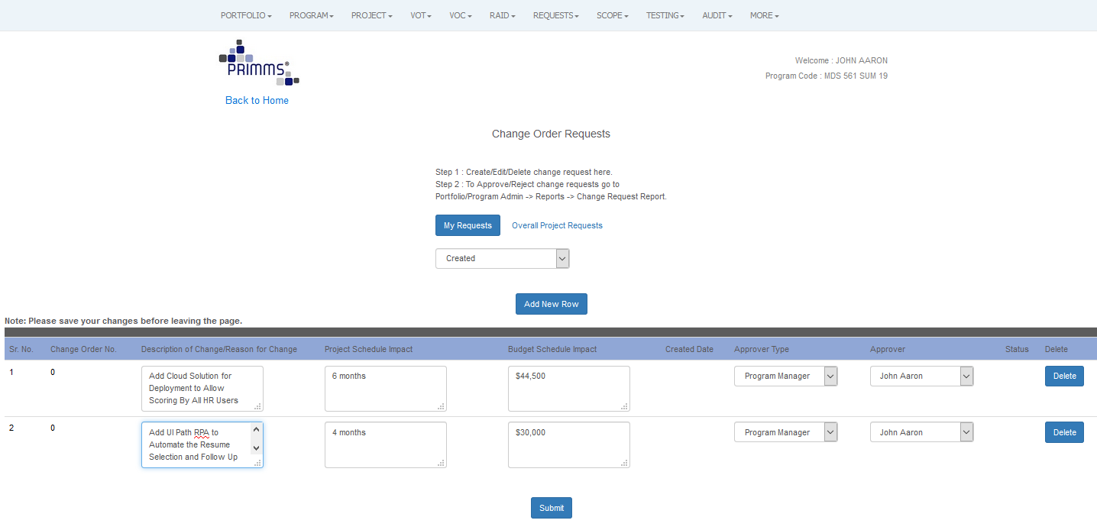
Completing and Submitting the Change Request Form

Slide 38
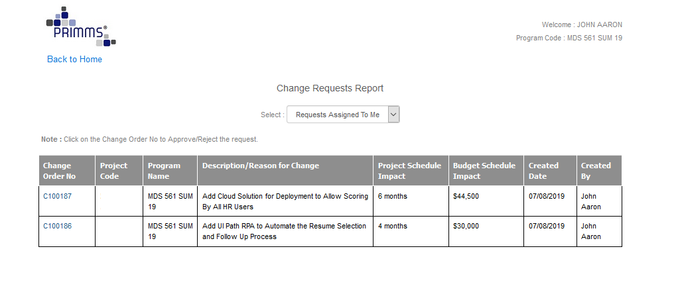
The Mechanics of Scope Change Control

Slide 39
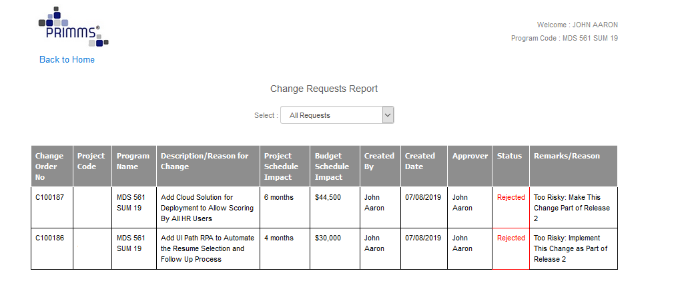
In This Case The Sponsor Rejects the Change Requests and The Project Team Maintains Its Original Scope
But the Team and Sponsor Agree That Release 2 Will Contain These Changes As Part of Its Scope
The Team Also Recognizes the Importance of Defining the Process Flow Chart

Slide 40
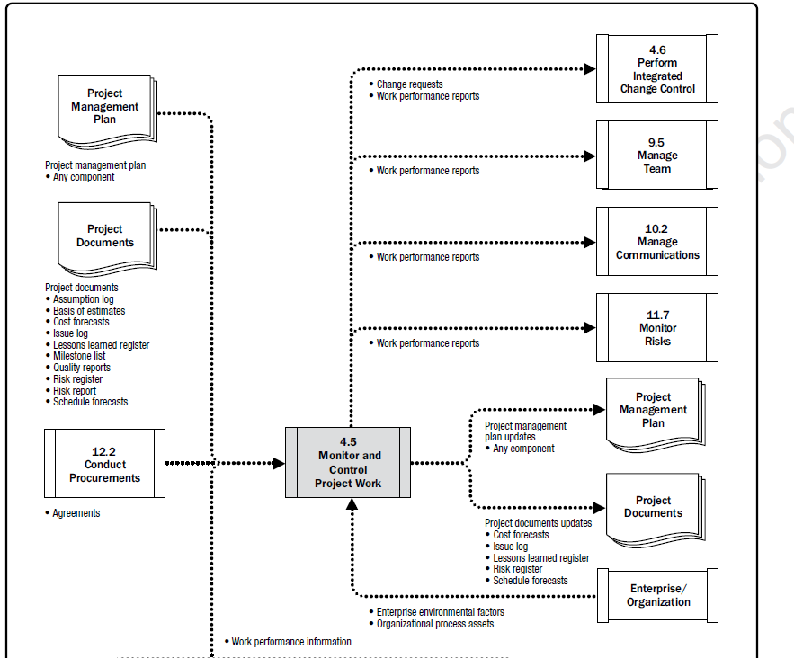
We Have Demonstrated Good Management Practices

Slide 41
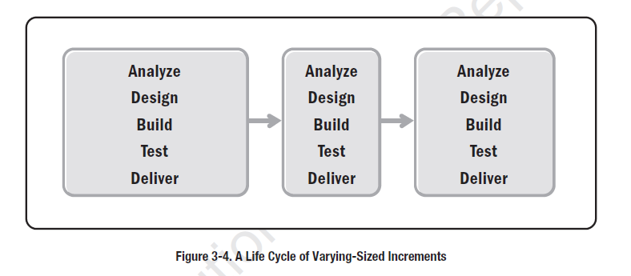
Release 2
Release 3
Release k
Future Releases May Take On the Standard Application Development Life Cycle But For Now We Are Staying Within CRISP-DM

Slide 42
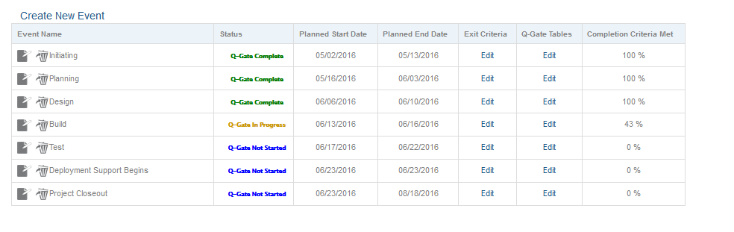
A Traditional Waterfall Development Life Cycle As Shown in PRIMMS

Slide 43
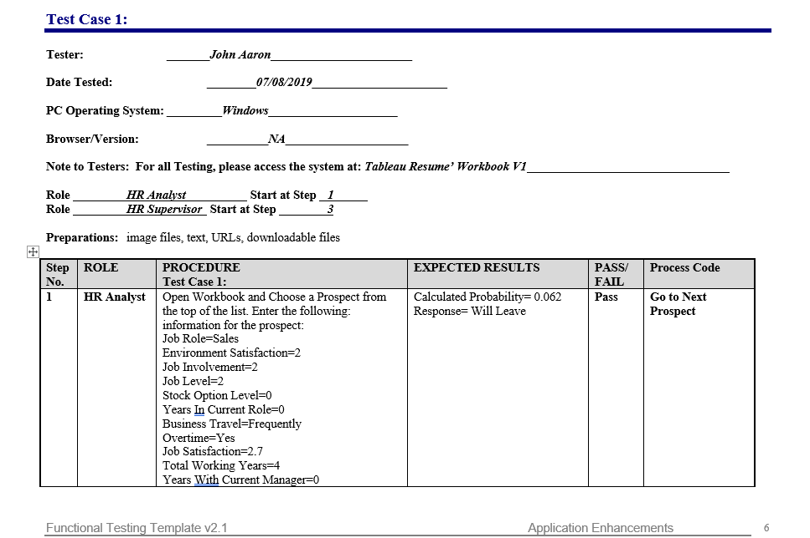
We Are Now Entering The Validation Phase---UAT and System Testing
Testing Results
Notice the Use of Rules

Slide 44
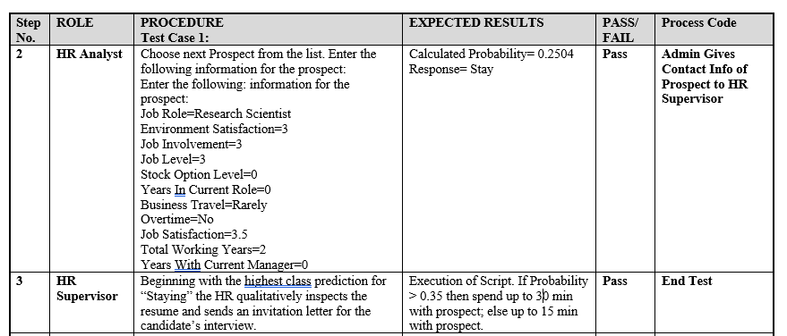
UAT and System Testing
Test Case #1 Continued

Slide 45
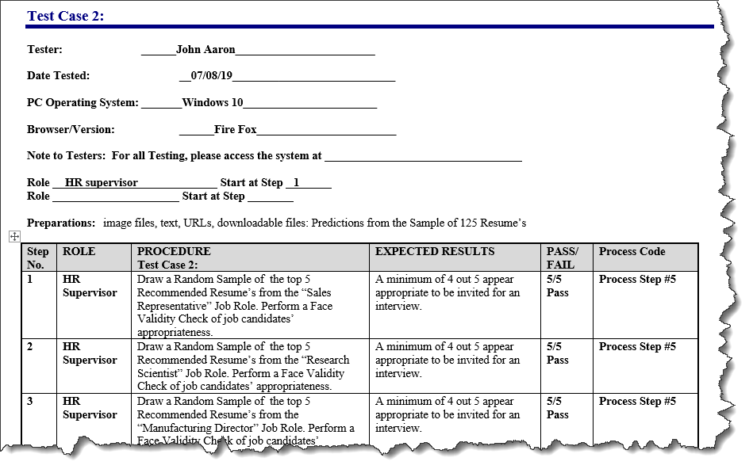

Slide 46
Certain Expectations of Quality Exist
Think of the Recent Boeing Disaster. Is it likely that proper testing was performed on that automated system?

Slide 48
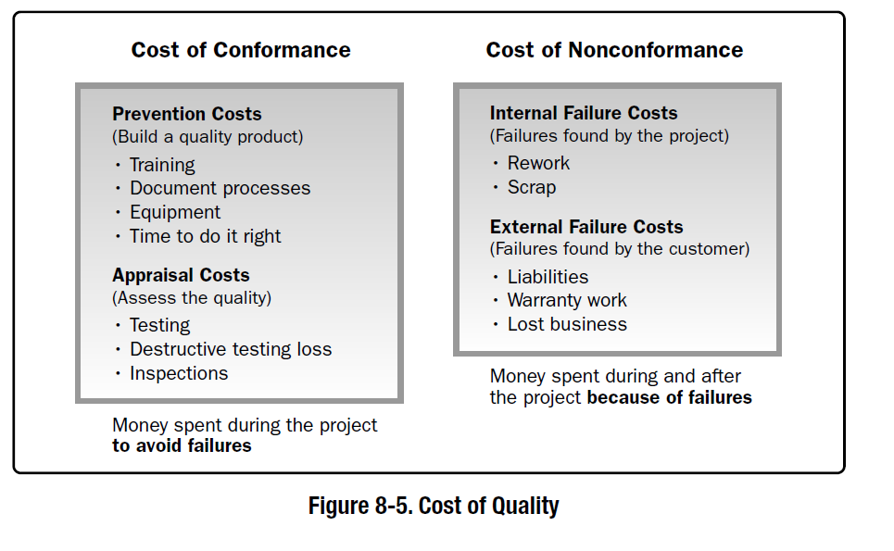
Over the Next Weeks We Will Spend Time on Test Execution, Today We Are Still Focused on Building the Deliverables to Be Tested

Slide 49
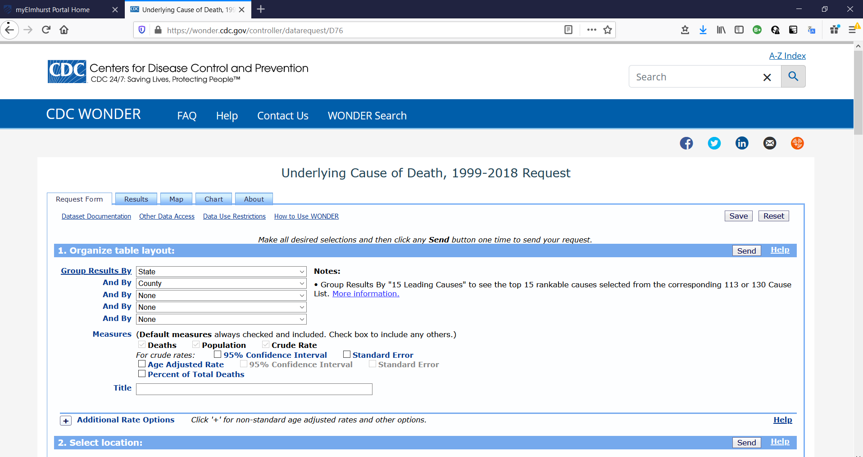
For Tripwire Metrics
https://wonder.cdc.gov/controller/datarequest/D76

Slide 50
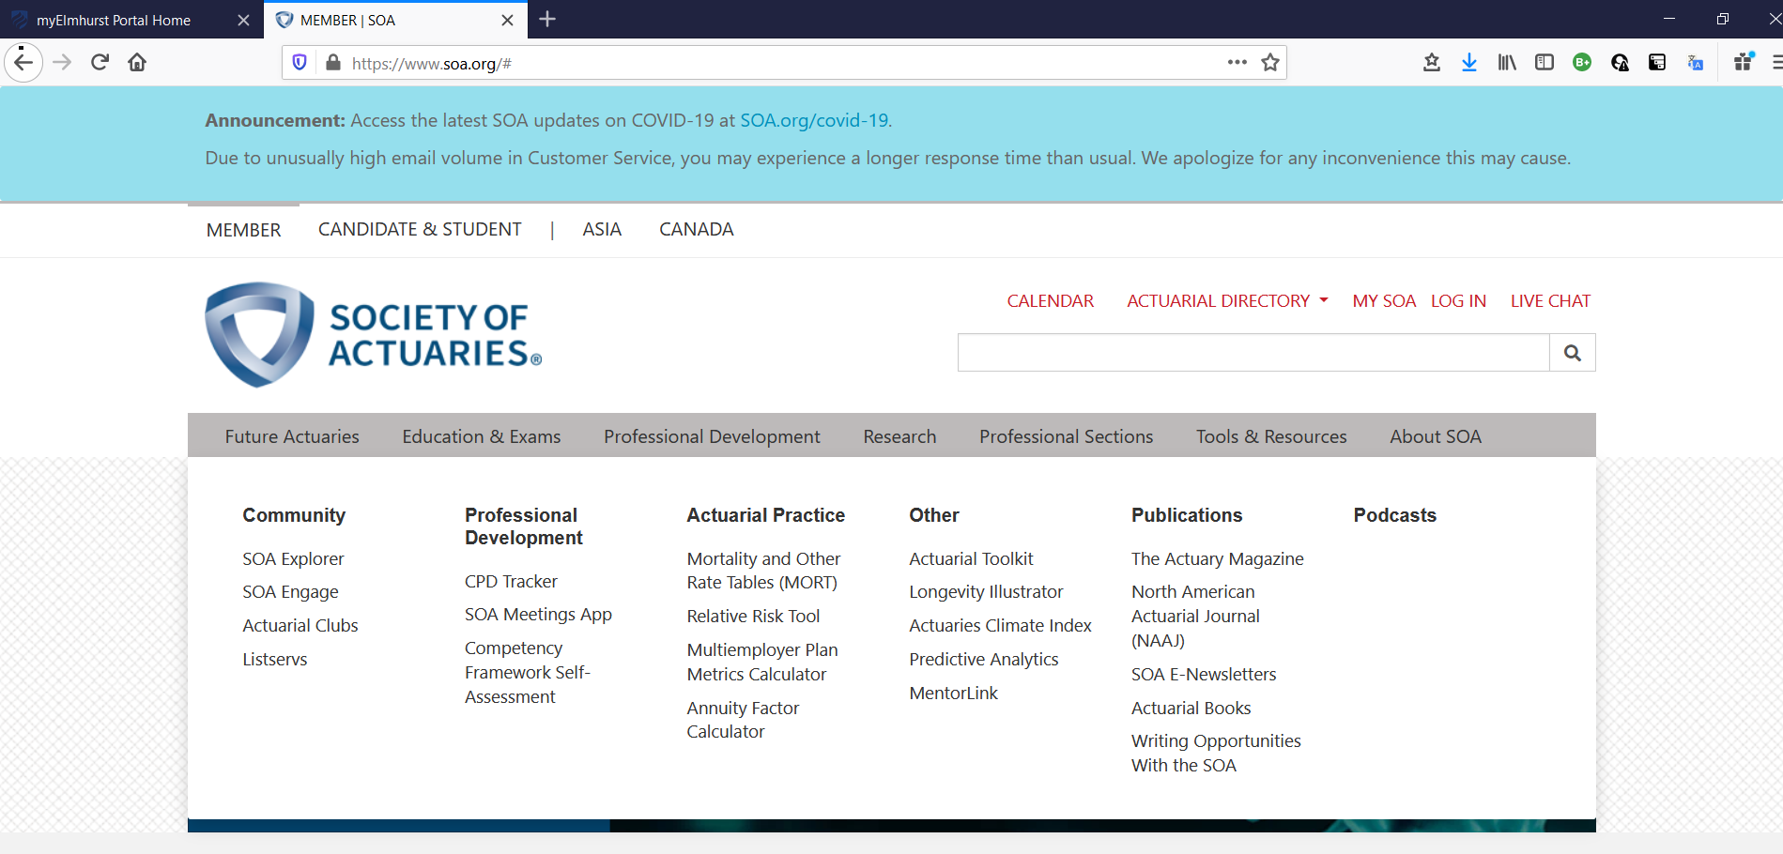

Slide 51

Reinforces the soundness of using a Bayesian Tripwire Metric

Slide 52
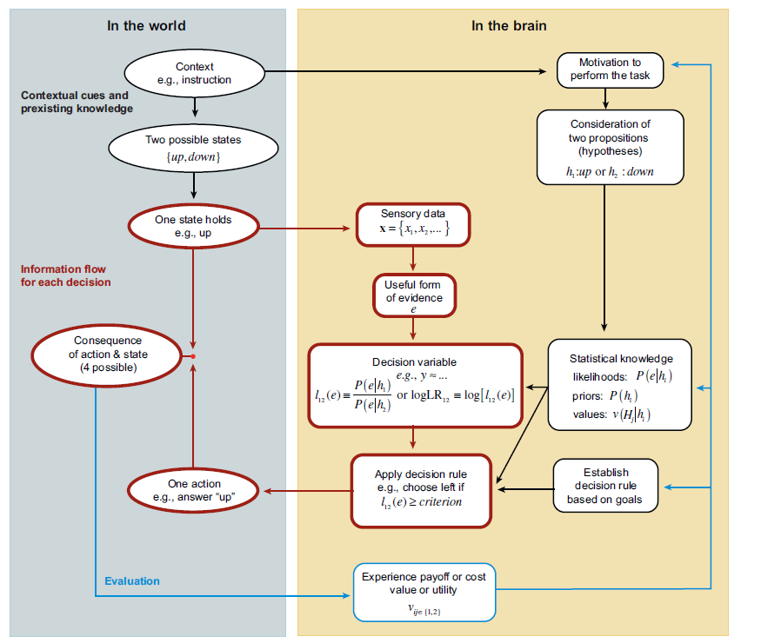

Slide 53
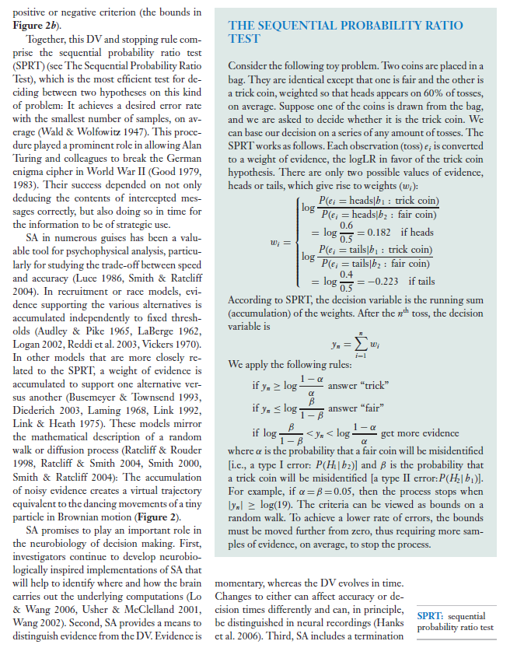
The author re-wrote I.J. Good’s 1950 Dice example.

Slide 54
